Slide 1
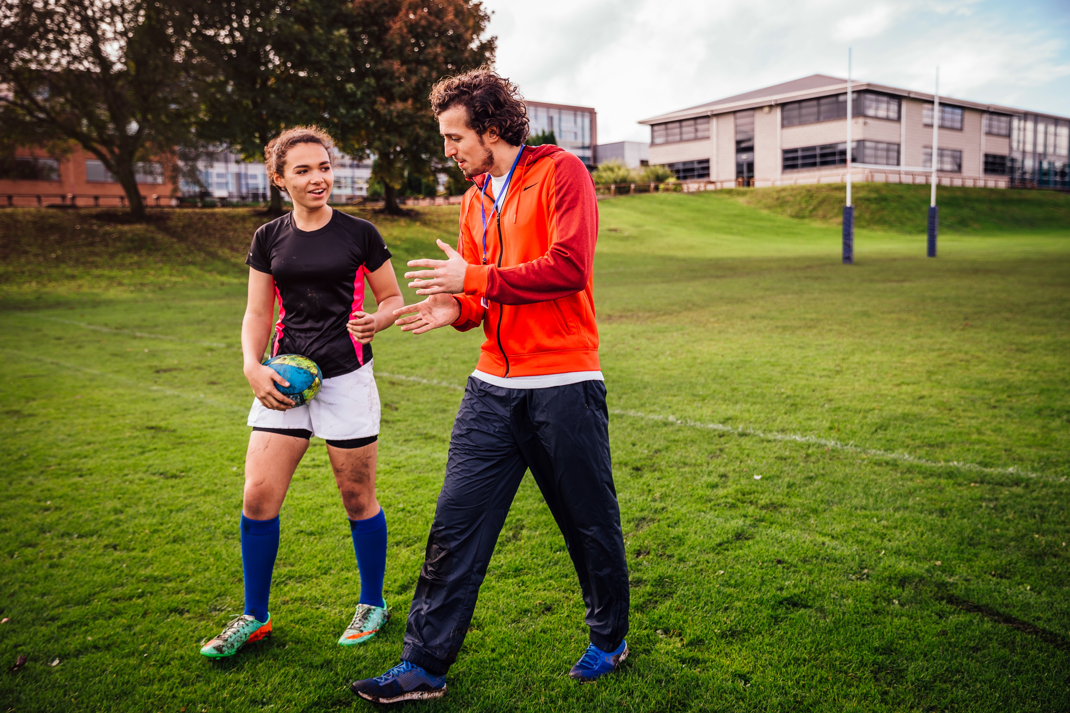
Grab and Go
Careers Sessions
Exploring careers in the sport and physical activity sector
Session: Welcome to the sector

Slide 2

If every sport and physical activity job disappeared tomorrow, what would society lose?

Slide 3
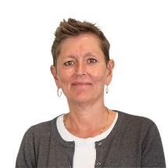
The sport and physical activity sector is one of the most inspiring, motivating, sociable, variable and interesting sectors I know.
No one day is the same, no one job is either. Imagine working in a sector where you can change lives every day, even save lives every day!
“
Tara Dillon
CEO of CIMSPA

Slide 4
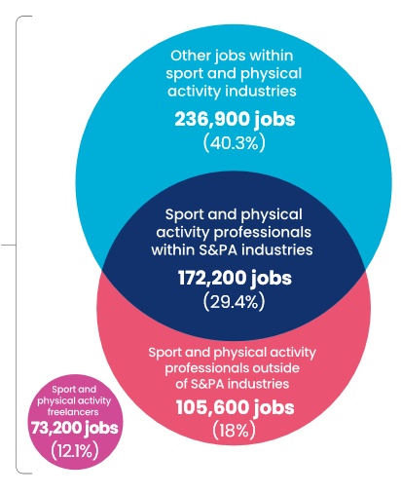
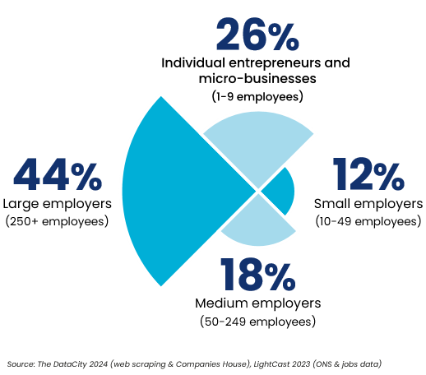
Welcome to our sector
Our sector has SIX industries
Community sport
Performance sport
Adventure sport
Exercise and fitness
Leisure operations
Health and wellbeing
Our sector workforce includes
586,000 people

Slide 5

What’s happening
in the sector
Through their work, sport and physical activity professionals contribute to a wide range of benefits
to society as a whole.
Influencing government policy
Reducing unemployment
Reducing pressure on healthcare services
Improving opportunities for disadvantaged groups
Recognising sport and physical activity professionals
Acting as role models for young people

Slide 6

Top advertised roles
in the sector
Personal Trainer | £30k per annum
Sports Coach | £28.4k per annum
Lifeguard | £26.2k per annum
Swimming Coach | £36.5k per annum
Swimming Instructor | £38.3k per annum
Football Coach | £36.5k per annum
Leisure Sales Manager | £26.4k per annum
Activities Assistant | £26.4k per annum
Activities Coordinator | £26.4k per annum
Fitness Coach | £26.4k per annum

Slide 7
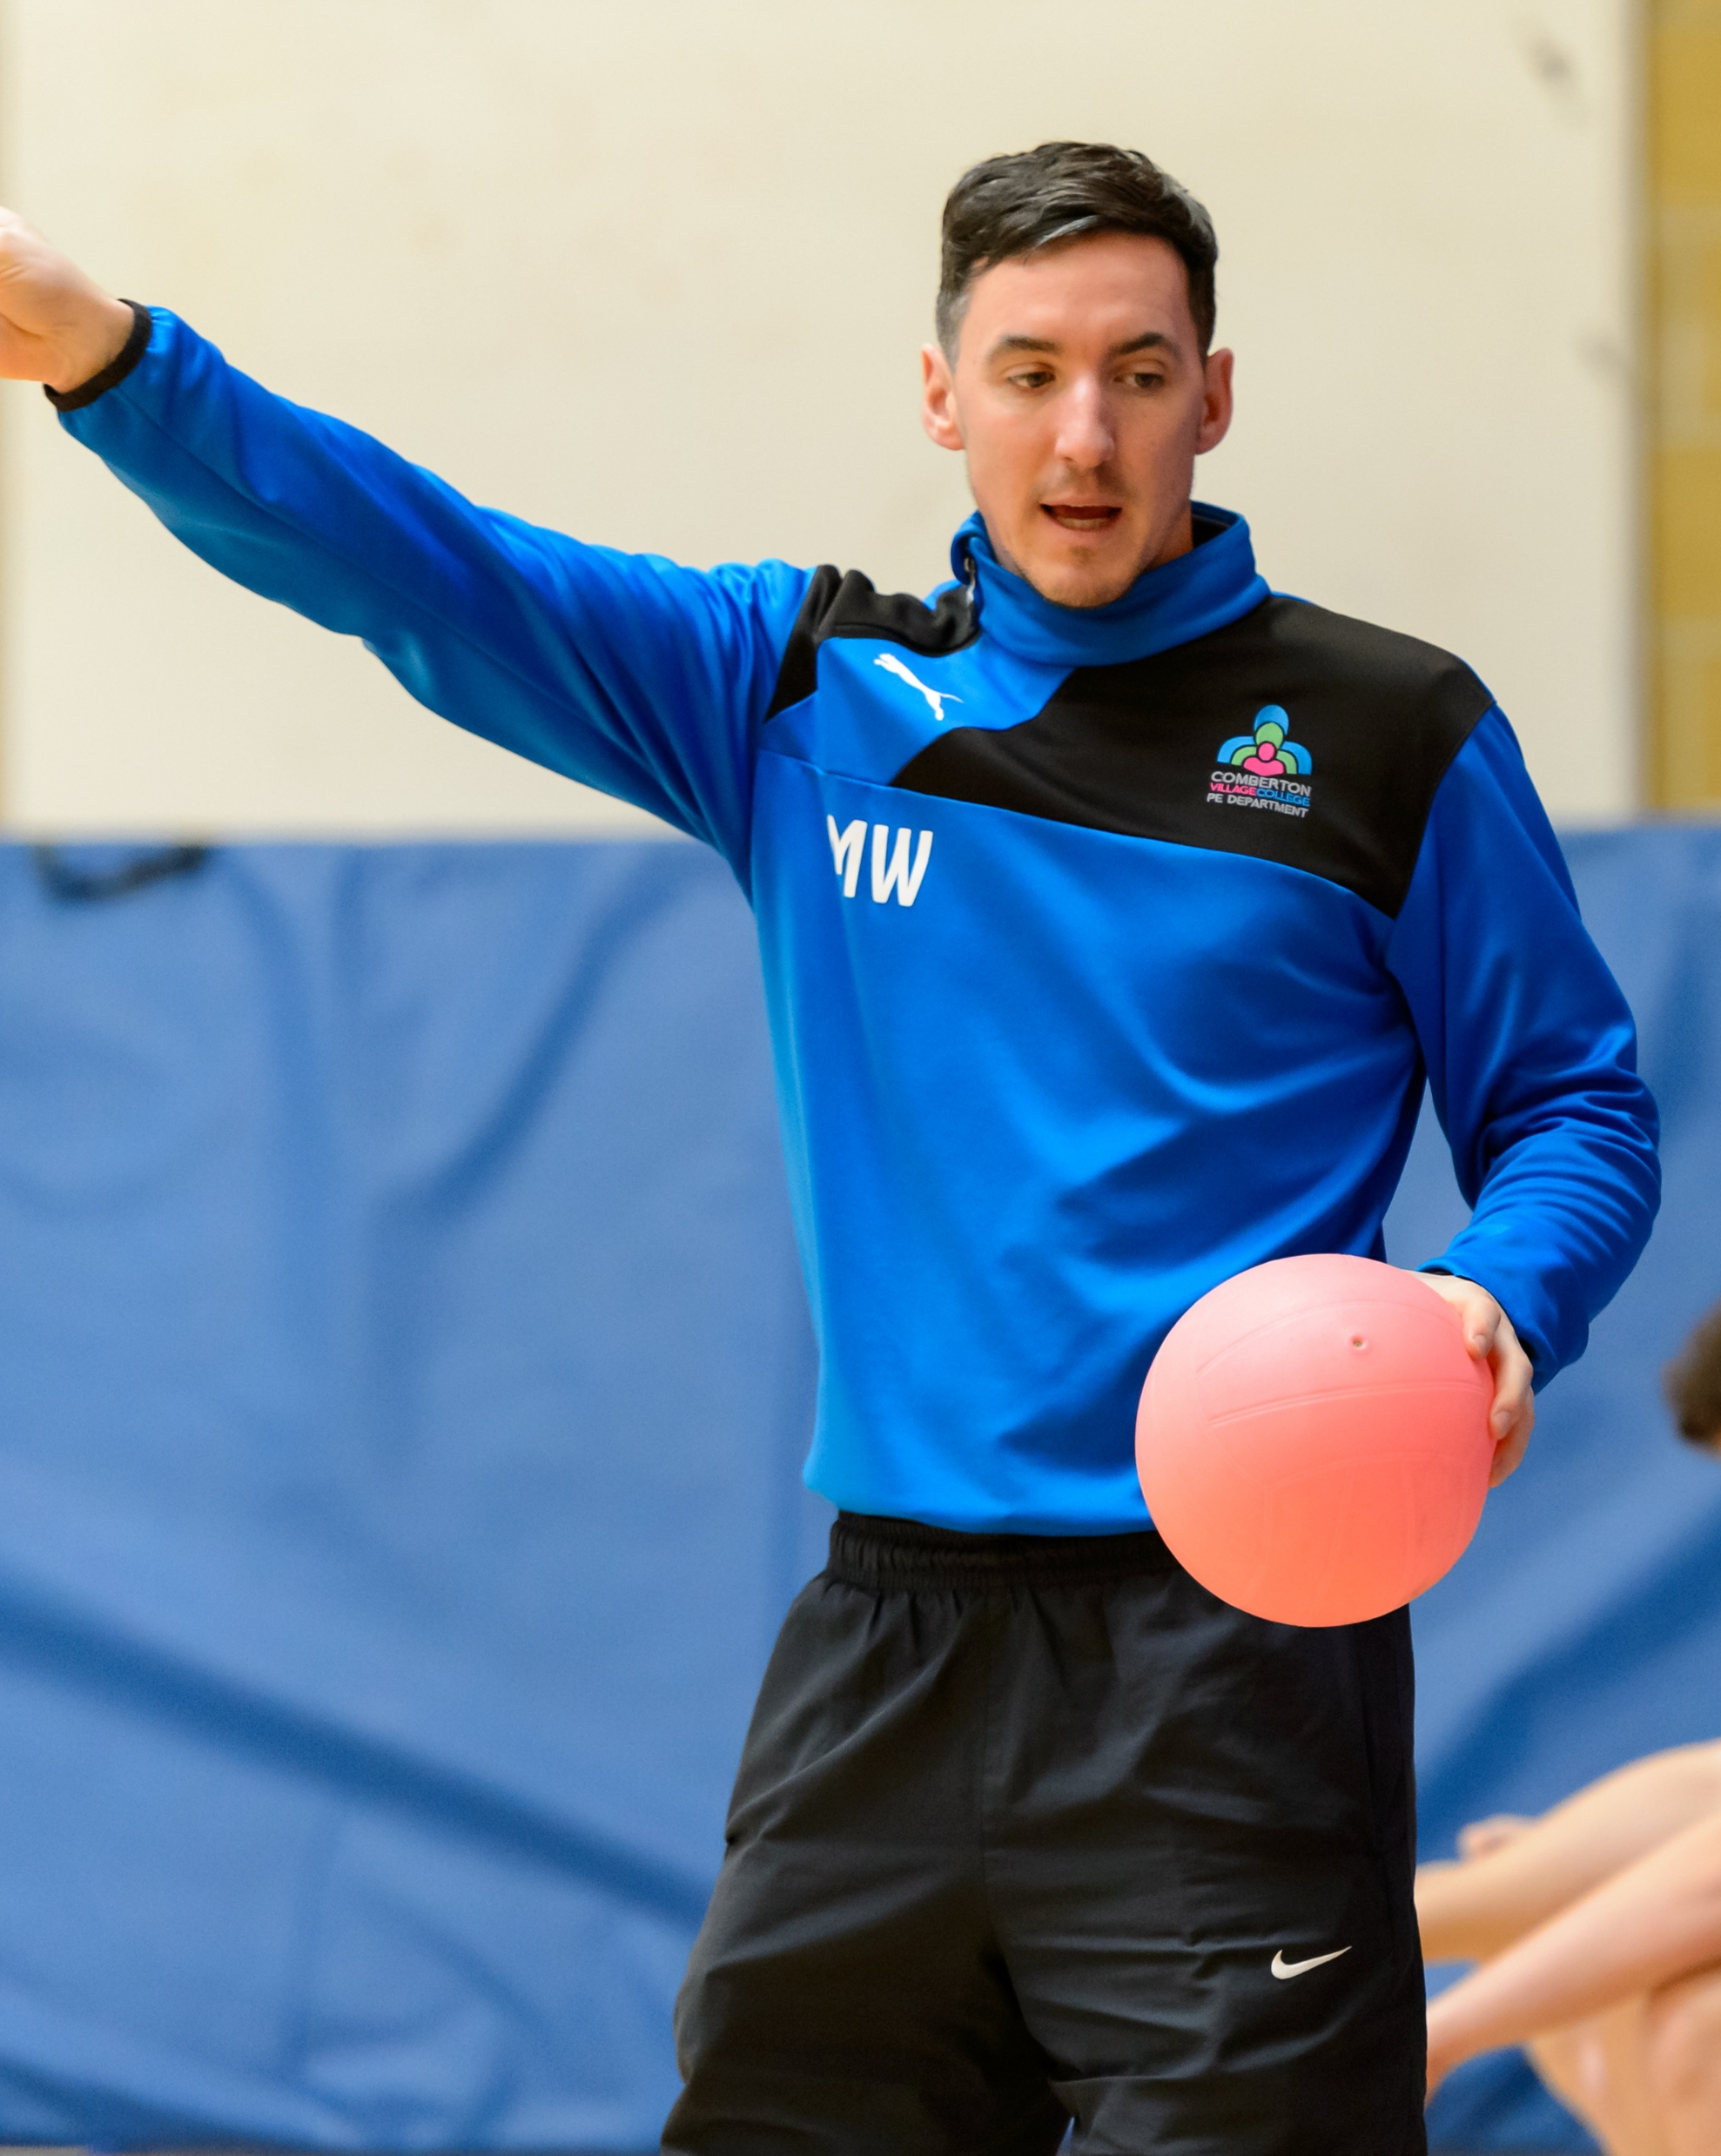
Myth Busting
“The only careers in sport are coaching
and personal training”
“You have to be really sporty to work in the sector”
“There aren't many jobs in the sector”
“You don't need qualifications”
“Once you're qualified, you've finished learning”
“The pay is always low”
“There's only one route into a career in sport”
“You'll spend all day in a gym”

Slide 8

What's one thing you've learnt today that changed how you think about the sport and physical activity sector?

Slide 9
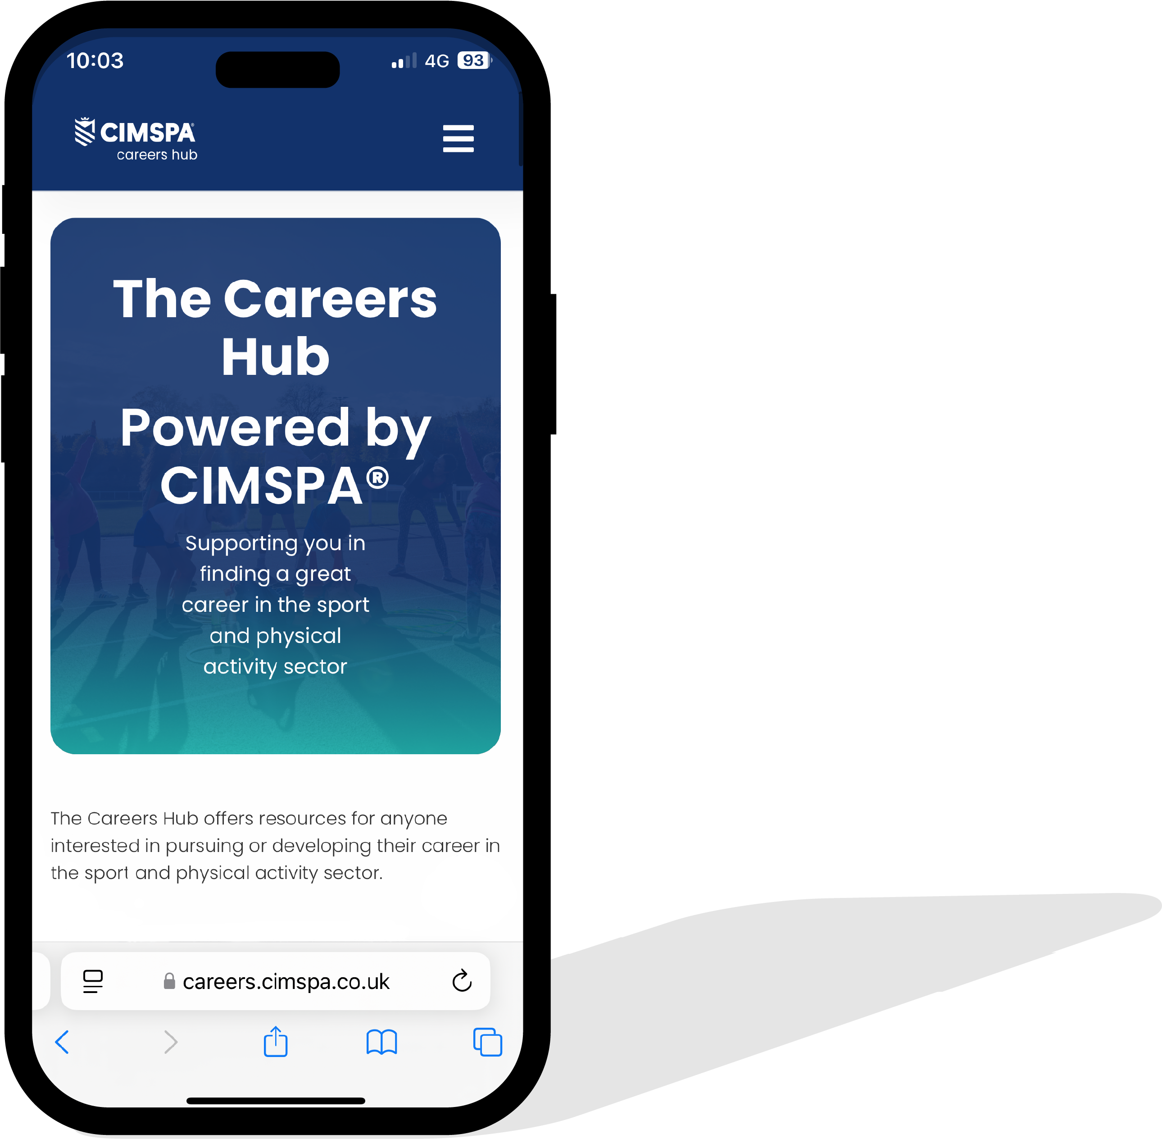
Careers Hub
The Careers Hub offers resources for anyone interested in pursuing or developing their career in the sport and physical activity sector.
We highlight the diverse and rewarding opportunities available and support individuals
from all backgrounds in entering an exciting
and dynamic industry that plays a crucial role
in promoting health, well-being, and community engagement across the UK.
Visit: www.careers.cimspa.co.uk

Slide 10



Slide 11
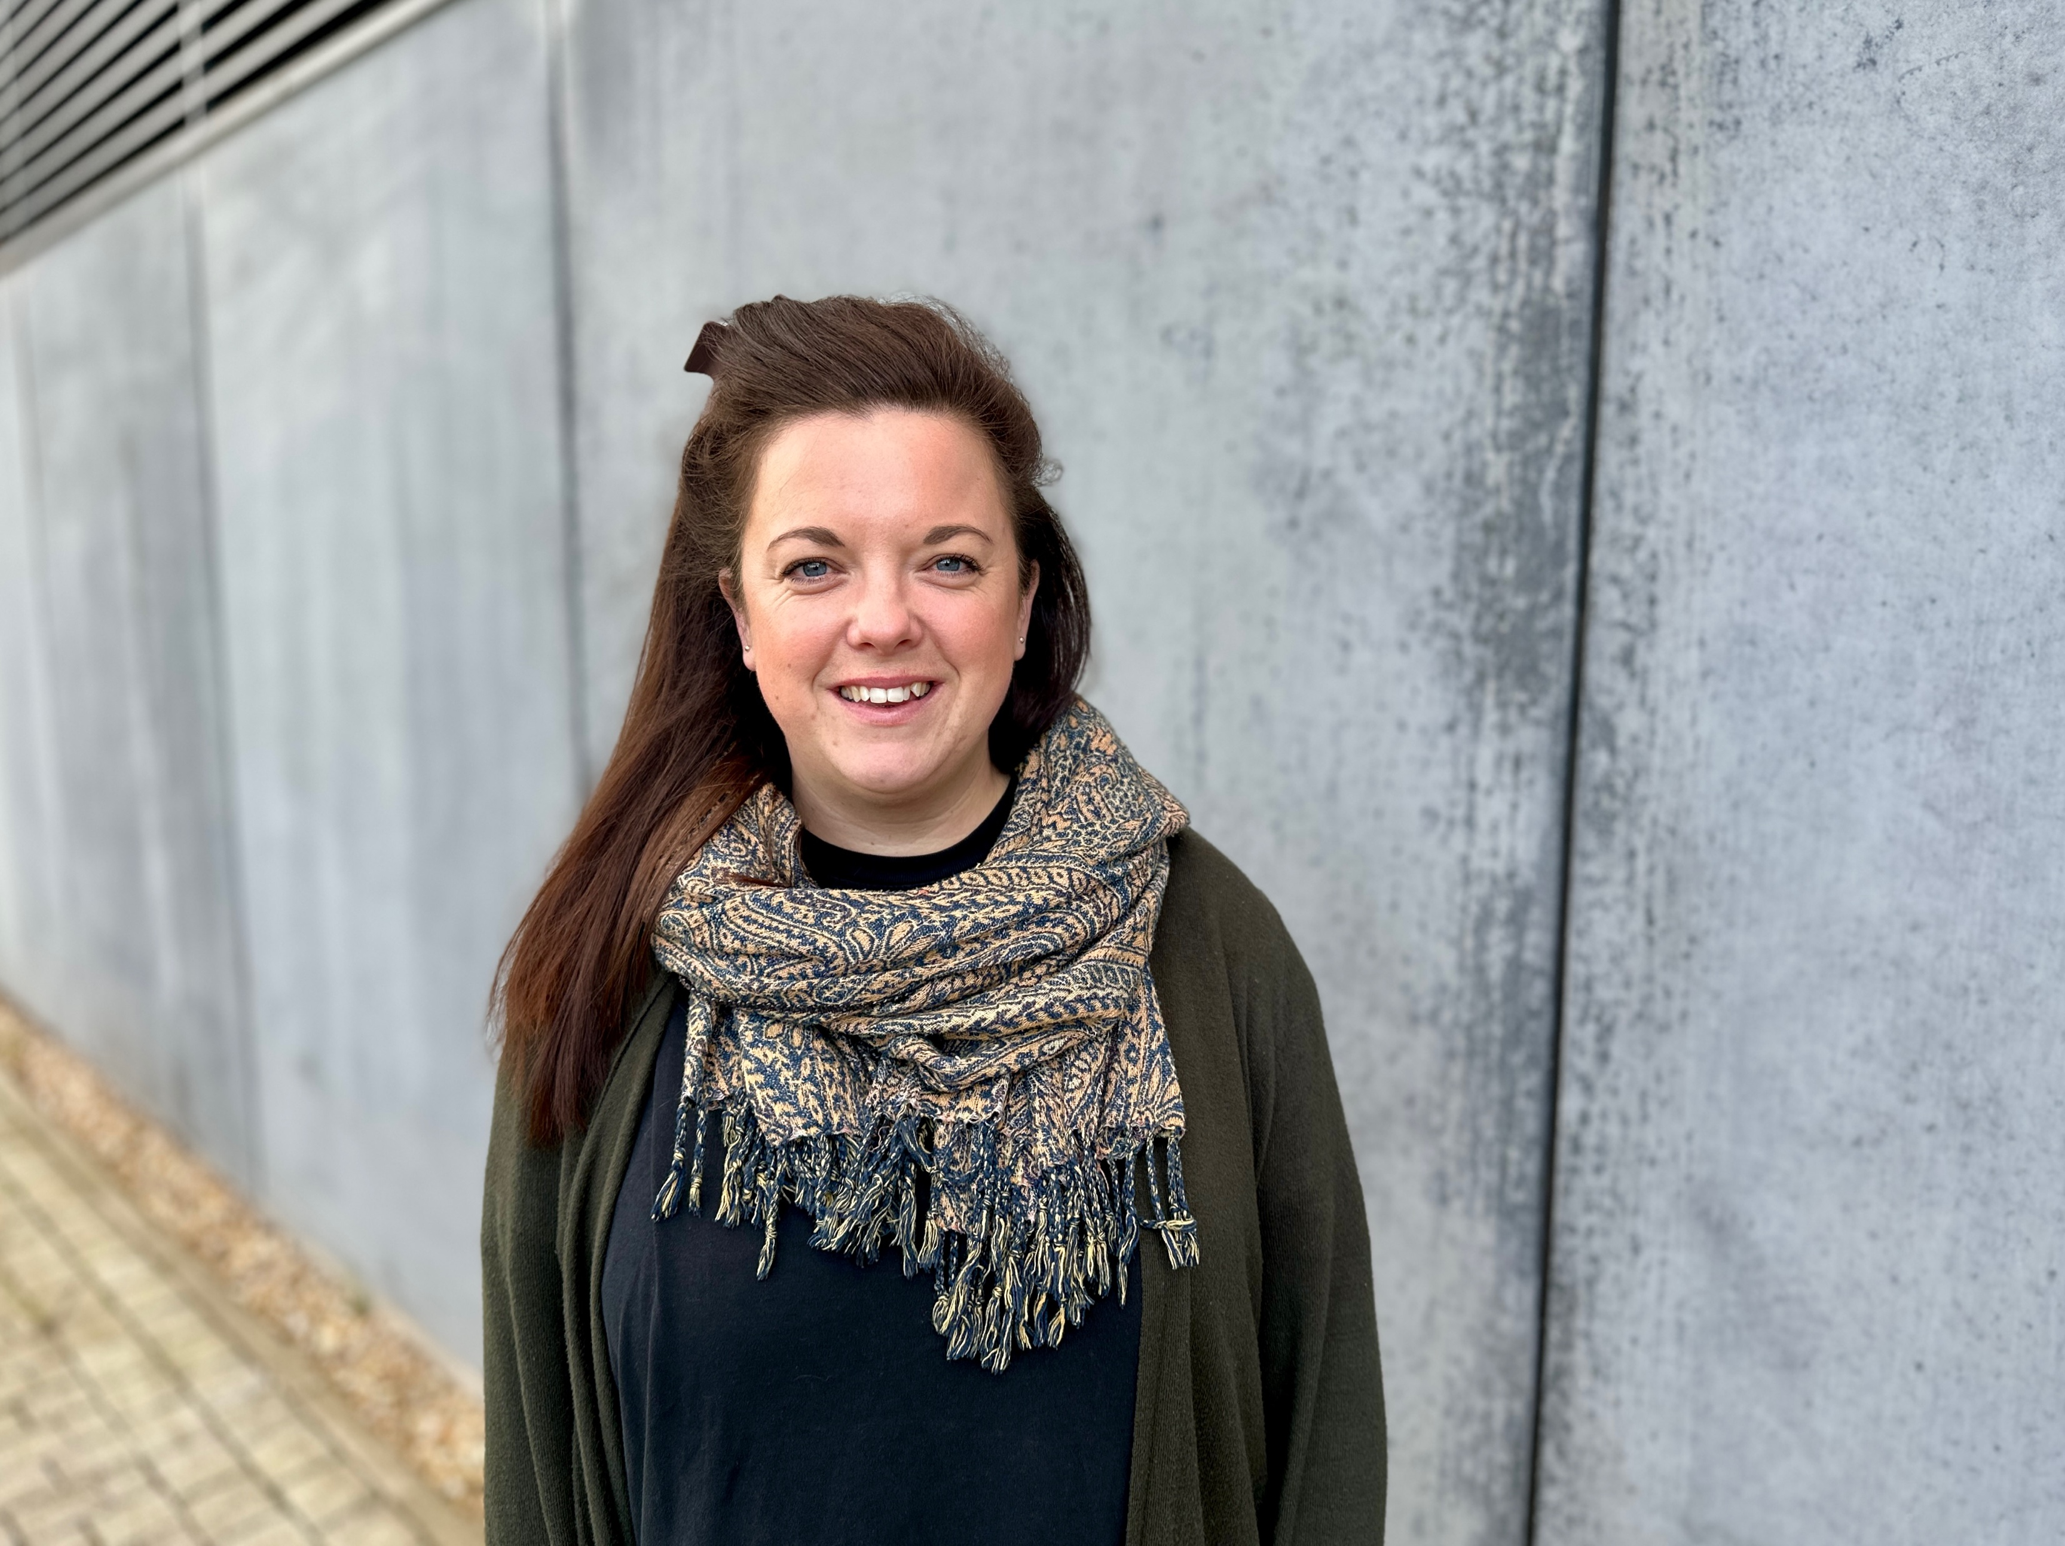
Find out more
www.cimspa.co.uk
CIMSPA Technical Education contact:
Micki Ruggins: micki.ruggins@cimspa.co.uk

