Slide 1

Grab and Go
Careers Sessions
Exploring careers in the sport and physical activity sector
Session: Explore careers

Slide 2

When you hear
'sport and physical
activity', what's the
very first job that
comes into your head?

Slide 3






Industry definitions
The Sport and Physical Activity sector is made up by
6 core industries and supported by training, education and development and sector bodies.
Each core industry offers different services and products for participants with the common goal of helping people lead active and healthy lives.
Exercise and Fitness
Leisure Operations
  Services, activities and venues that predominantly improve participant physical fitness.
Services, activities and venues that predominantly improve participation in physical activity.
Health and Wellbeing
Performance Sport
Holistic services and activities that promote improvements across all aspects of health, sometimes involving health care and other non-sector professionals.
Competitive sport and activities in which
athletes receive payment for their performance.
Community Sport
Adventure Sport
Sport/skill based services, activities and venues
that increase participation and develop skill, sometimes targeting under represented groups
and inequalities.
Activities, services and venues both indoor and outdoor improving participation in physical
activity perceived as having a high level of risk.

Slide 4
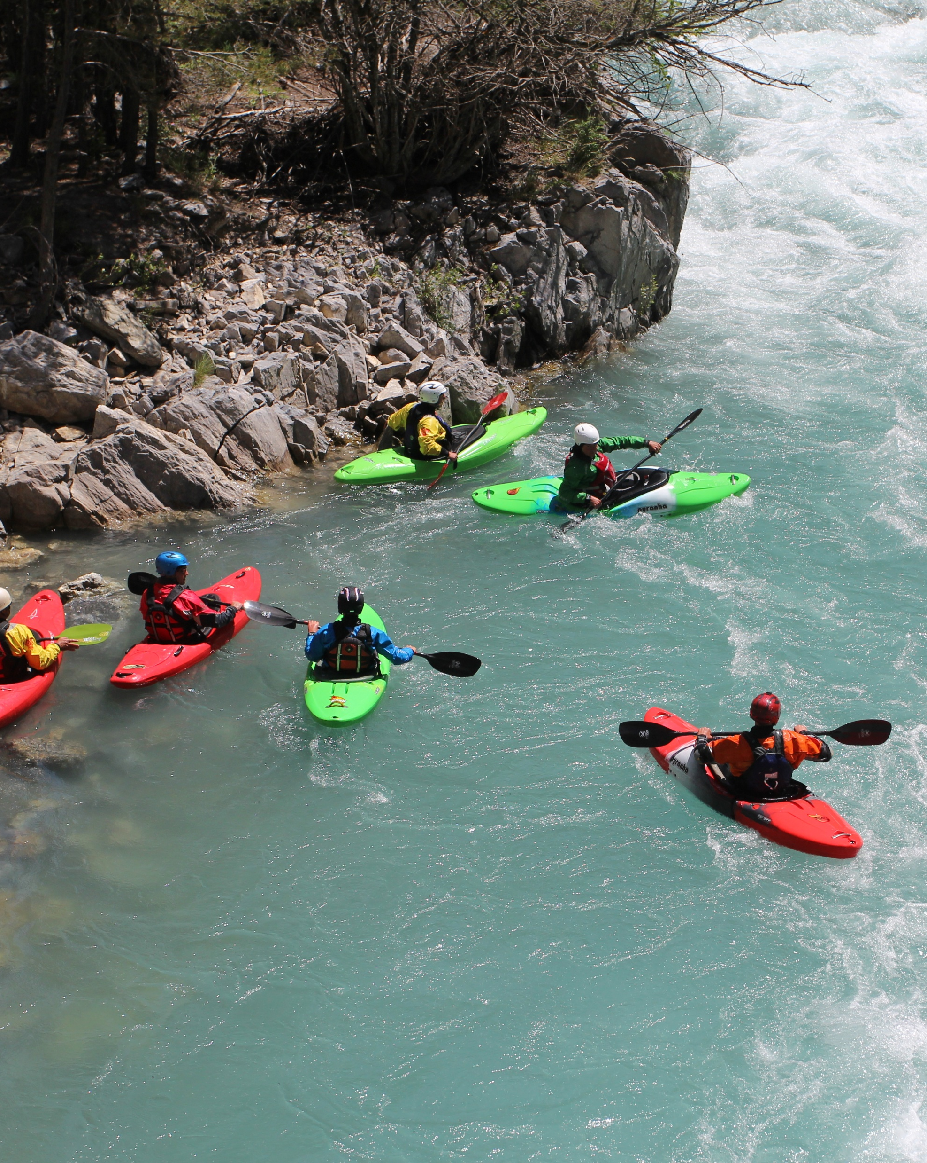


Slide 5
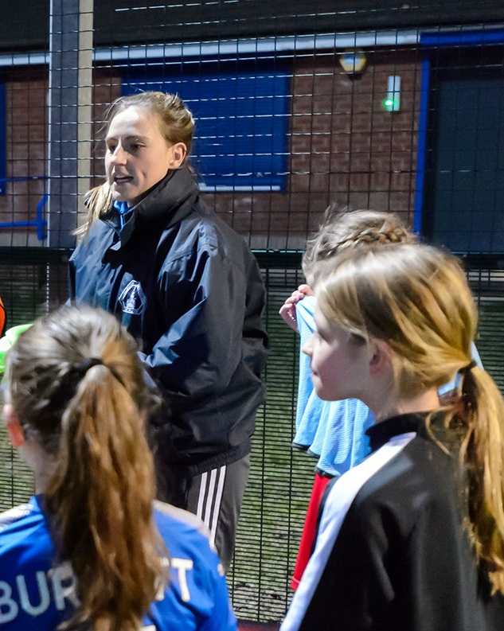


Slide 6



Slide 7



Slide 8



Slide 9
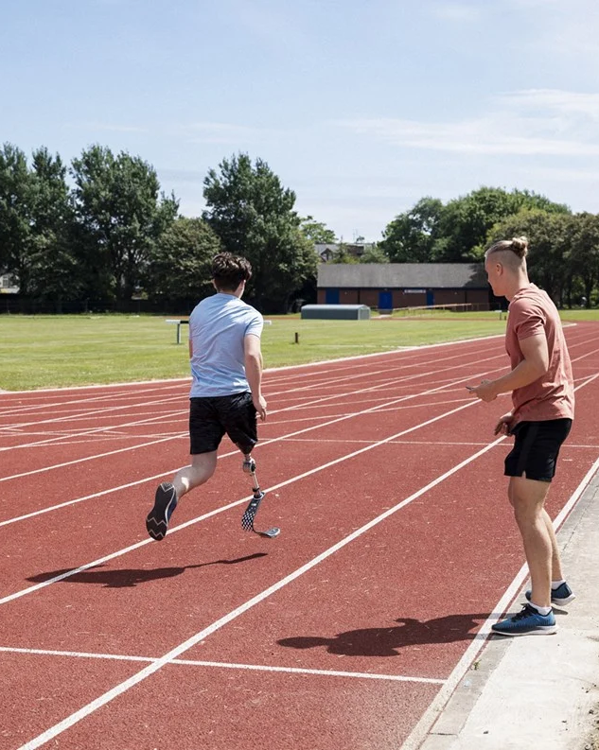


Slide 10
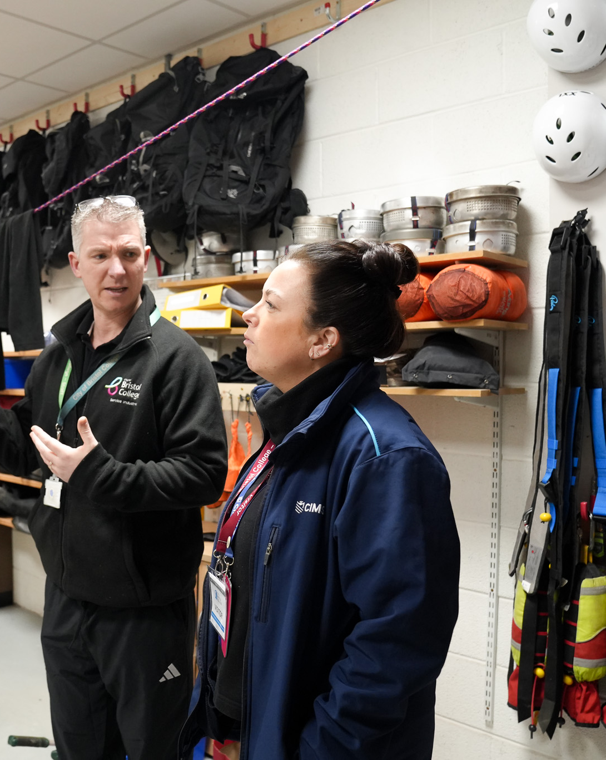

Career and occupation quiz
Answer questions about what you enjoy most
and get instant results on which careers and occupations in the sport and physical activity sector might be best for you.
www.careers.cimspa.co.uk/your-career/quiz/

Slide 11
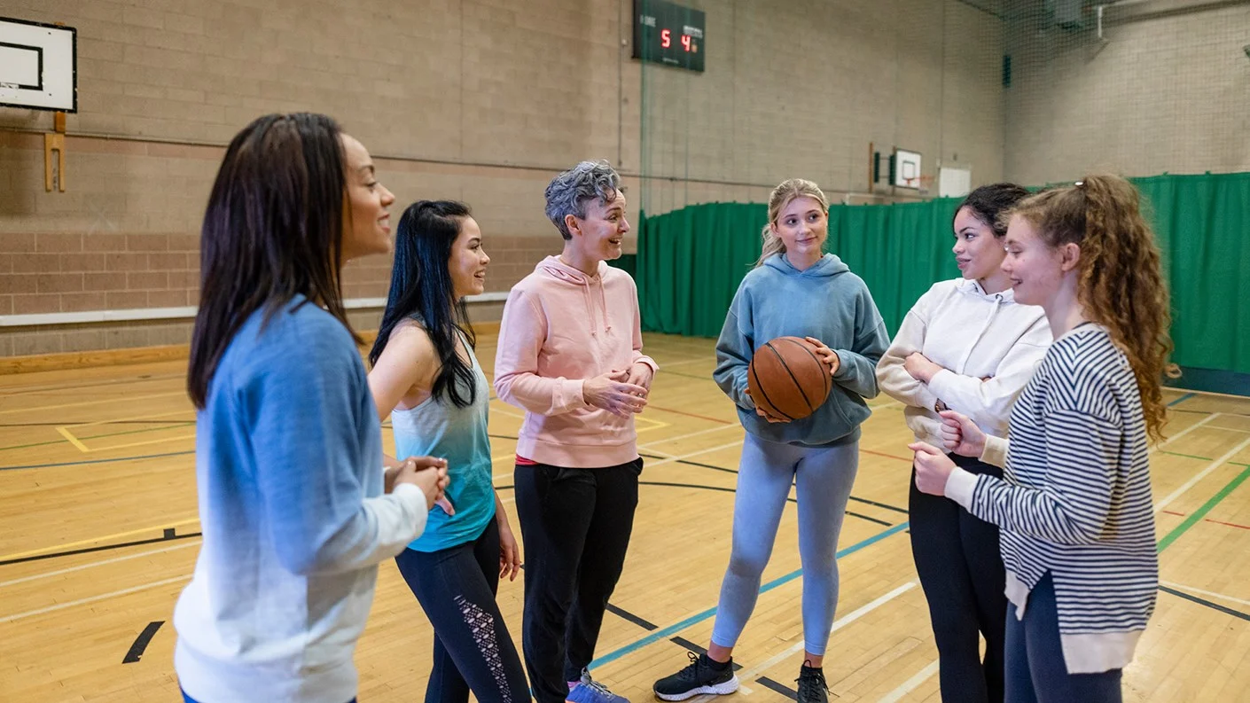
Which career has interested or surprised you the most, and why?

Slide 12
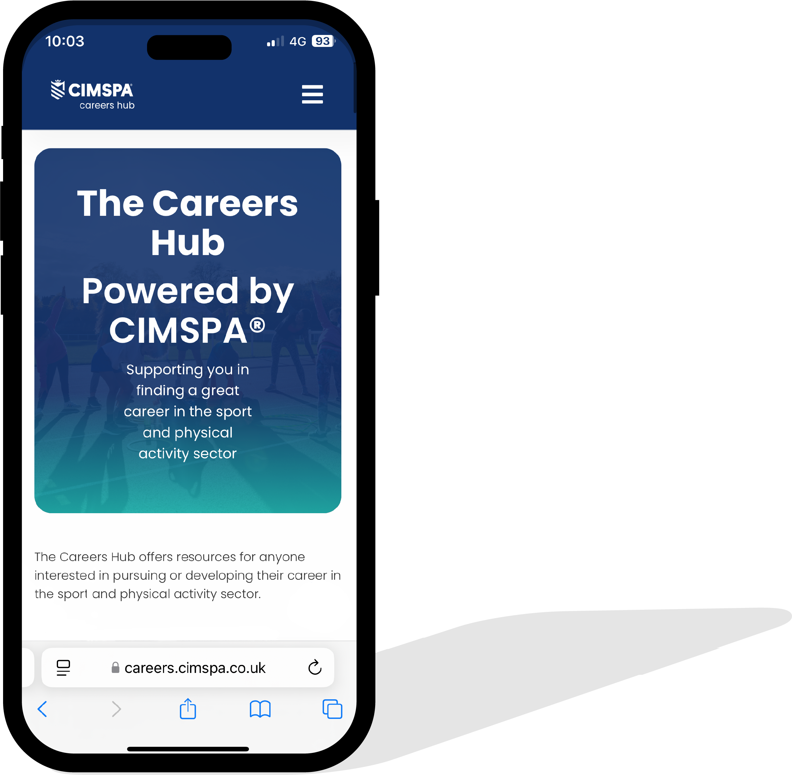
Careers Hub
The Careers Hub offers resources for anyone interested in pursuing or developing their career in the sport and physical activity sector.
We highlight the diverse and rewarding opportunities available and support individuals
from all backgrounds in entering an exciting
and dynamic industry that plays a crucial role
in promoting health, well-being, and community engagement across the UK.
Visit: www.careers.cimspa.co.uk

Slide 13



Slide 14

Find out more
www.cimspa.co.uk
CIMSPA Technical Education contact:
Micki Ruggins: micki.ruggins@cimspa.co.uk

