Slide 1

Grab and Go
Careers Sessions
Exploring careers in the sport
and physical activity sector
Session: Real careers

Slide 2
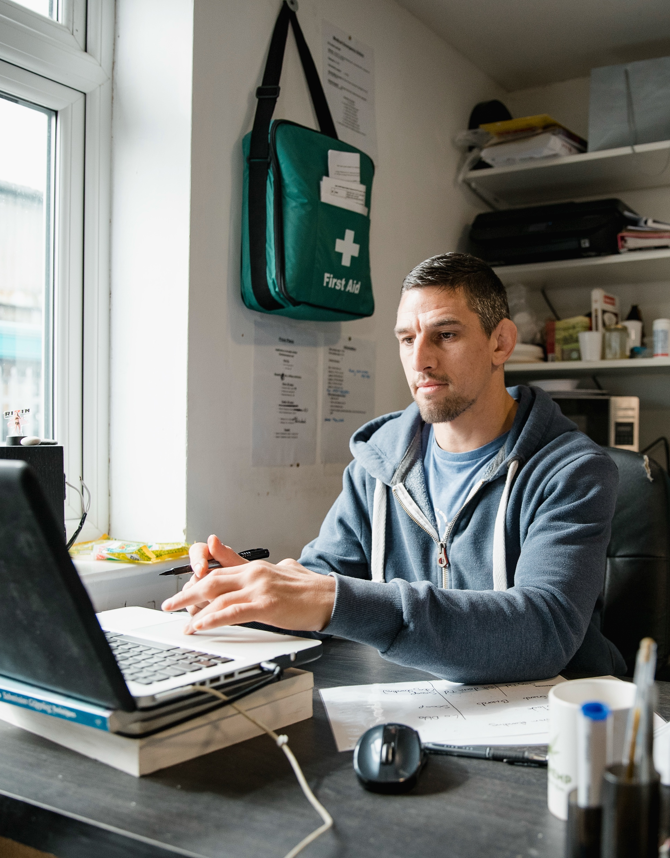
If you worked in sport
and physical activity,
what do you think
you'd spend most
of your day doing?

Slide 3


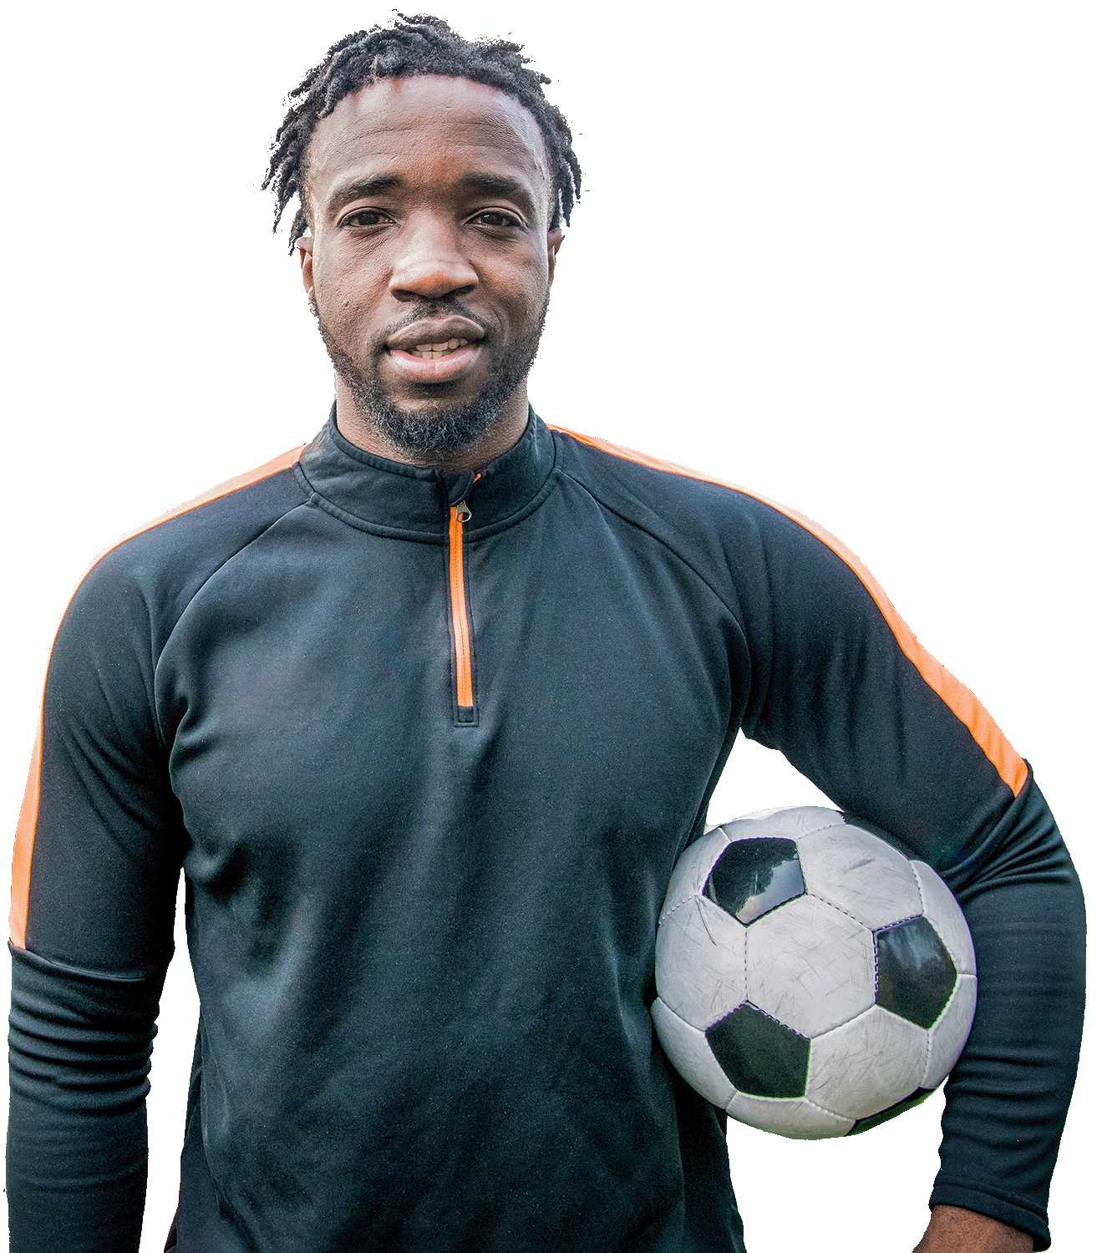
CIMSPA will support and inspire our people to always be:
For example, we will show a personal trainer an attractive and achievable career pathway to rewarding work in cancer rehabilitation with the health sector as a respected professional.

Slide 4
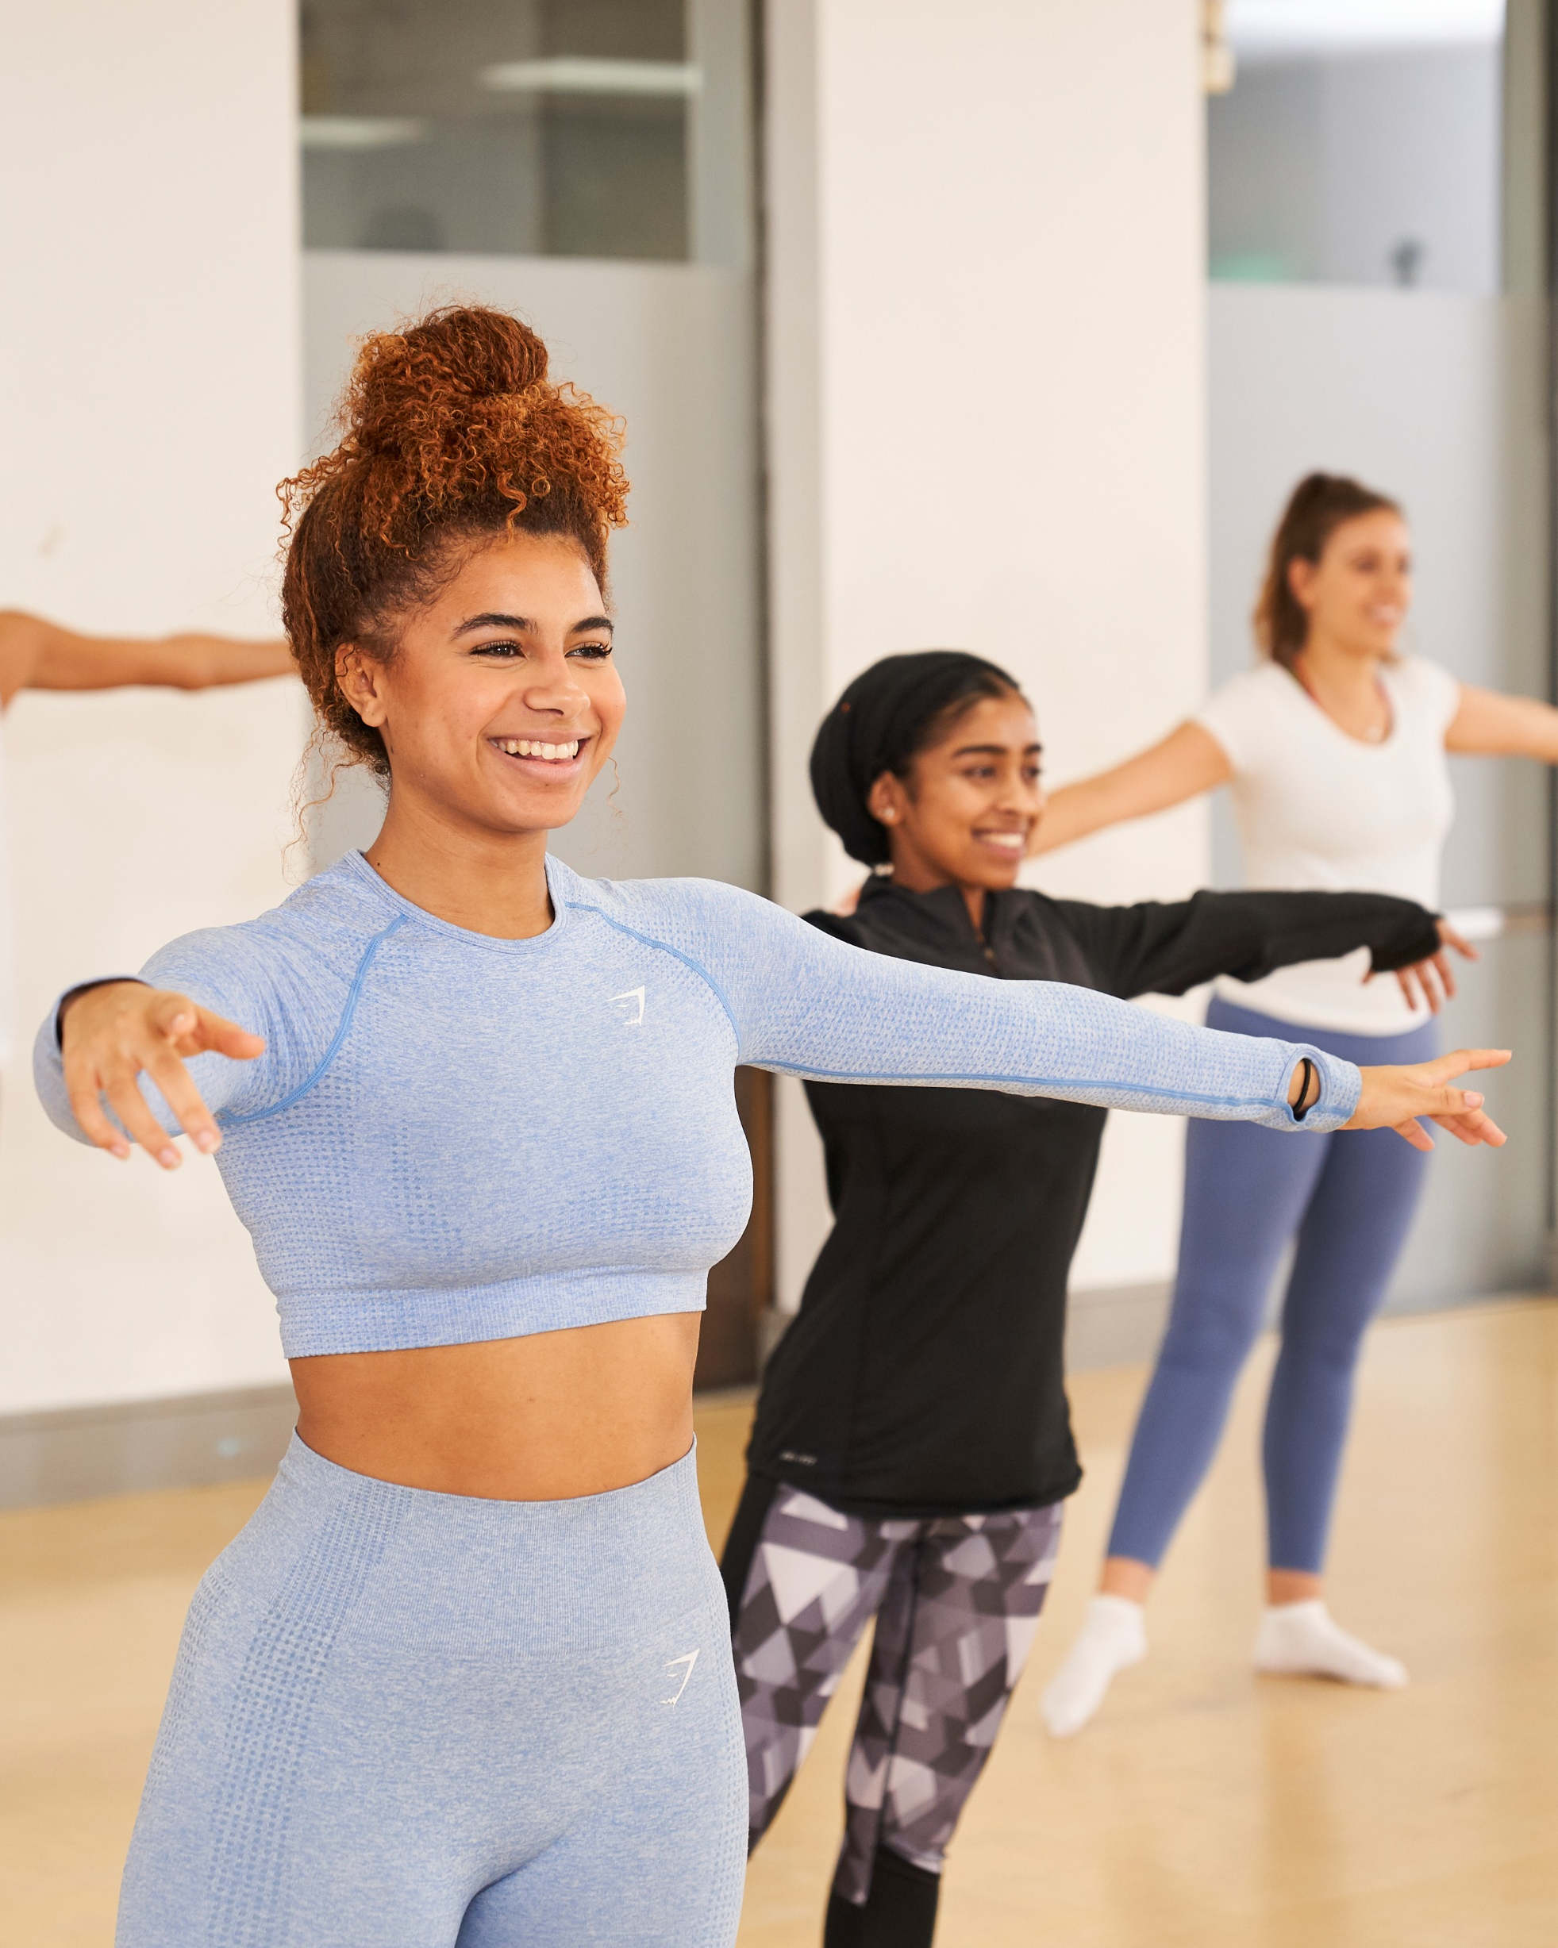


I am More Than just
a group exercise instructor:
I bring people together and improve the quality of their lives.
I enable positive mental health and reduced stress in my customers through our shared activity.
I deliver business success –
great exercise experiences
creates loyal customers.
I am an entrepreneur and
an event organiser.

Slide 5
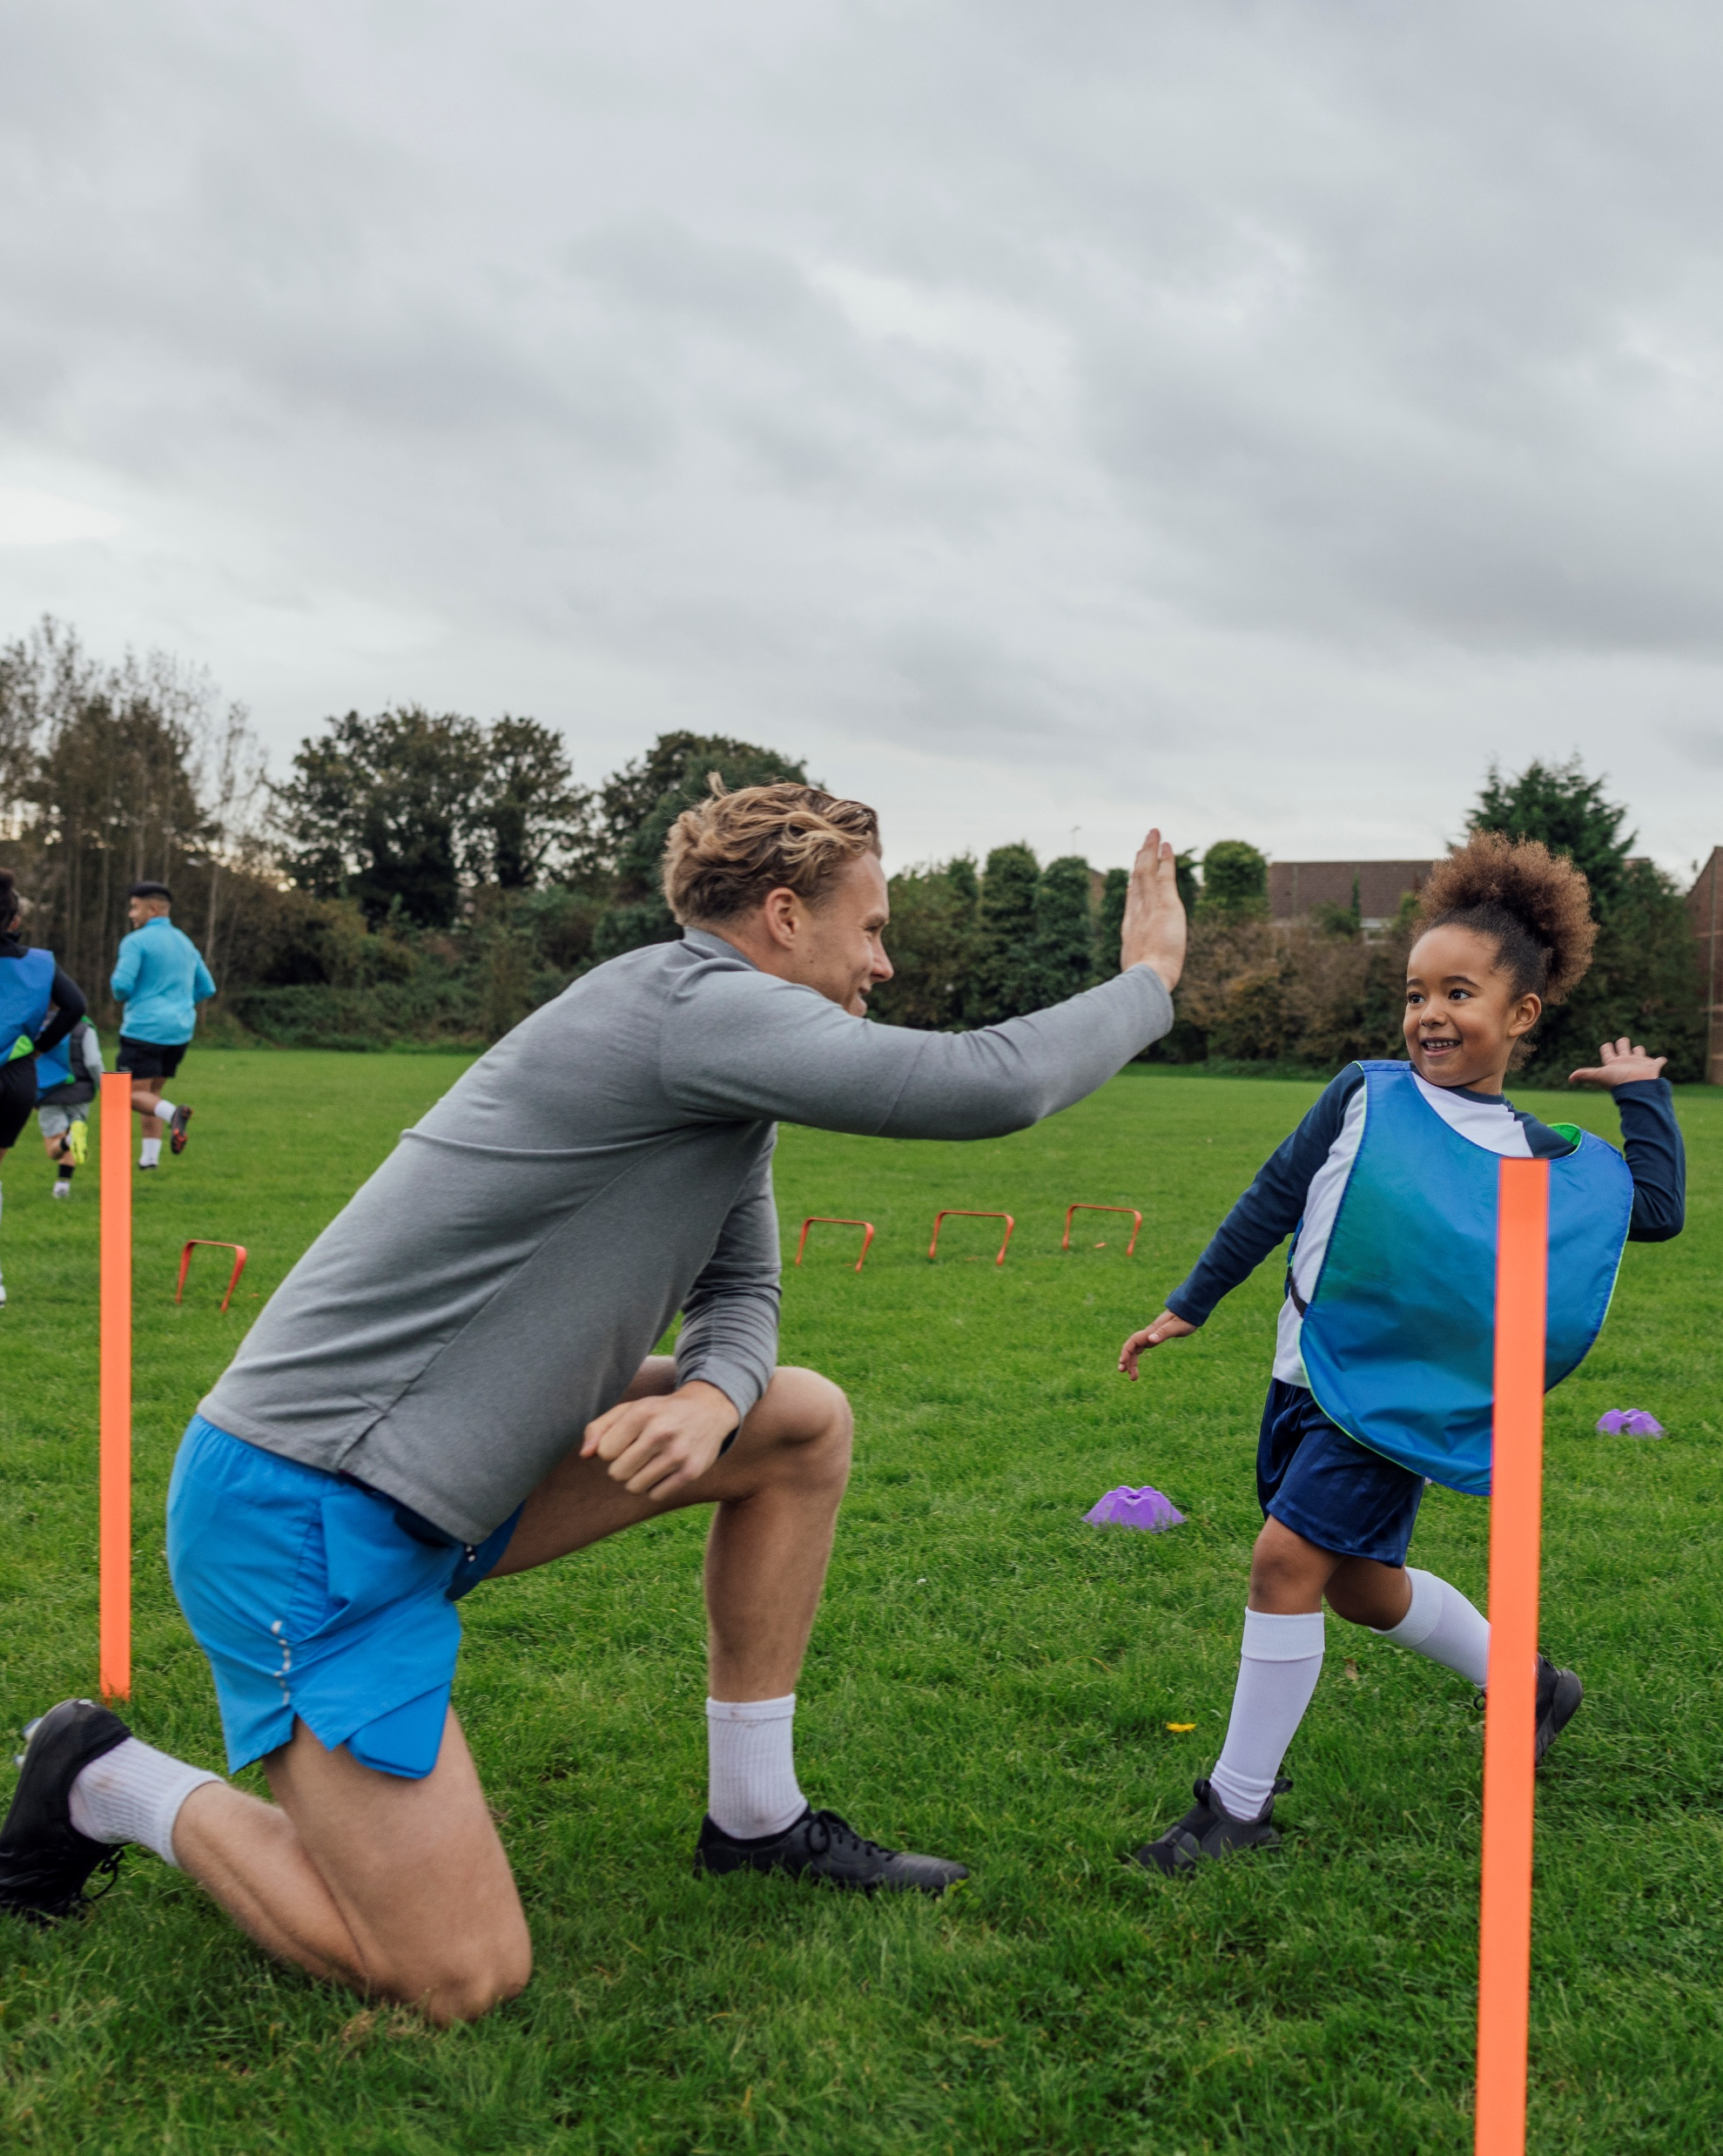
I am More Than just
a football coach:
The local sport my coaching supports helps builds social cohesion, a sense of belonging
and stronger communities.
I create a welcoming, inclusive environment that encourages social connection and sporting diversity in my local community.

Slide 6
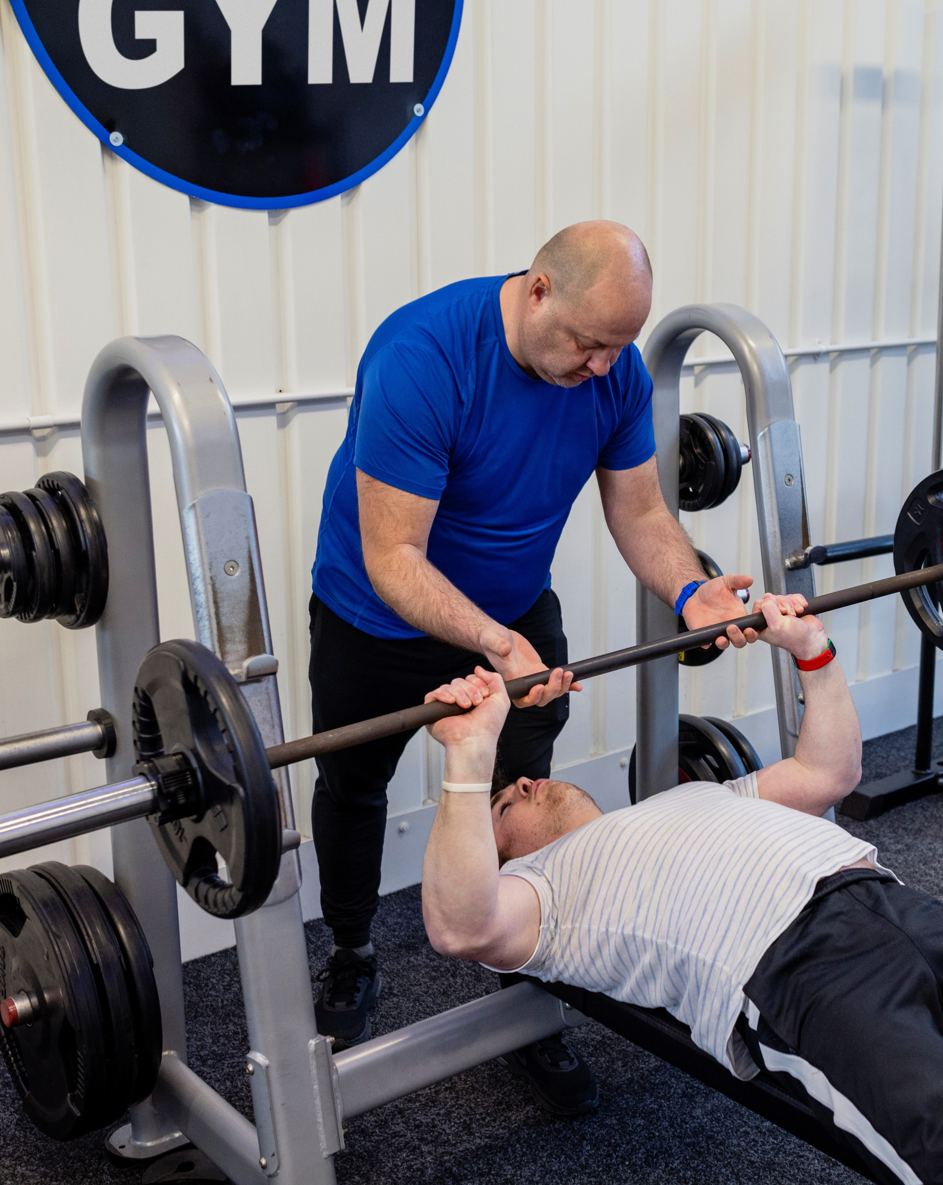
I am More Than just
a personal trainer:
I transform lives through movement, motivation,
and mindset.
I empower individuals to reach their goals – building confidence, strength, and long-term healthy habits.
I support mental wellbeing, helping people reduce
stress, anxiety, and self-doubt through fitness.
I drive business success – every tailored session
builds client trust, retention, and reputation.
I am a mentor, a motivator, and a role model
– in the gym and in the community.

Slide 7

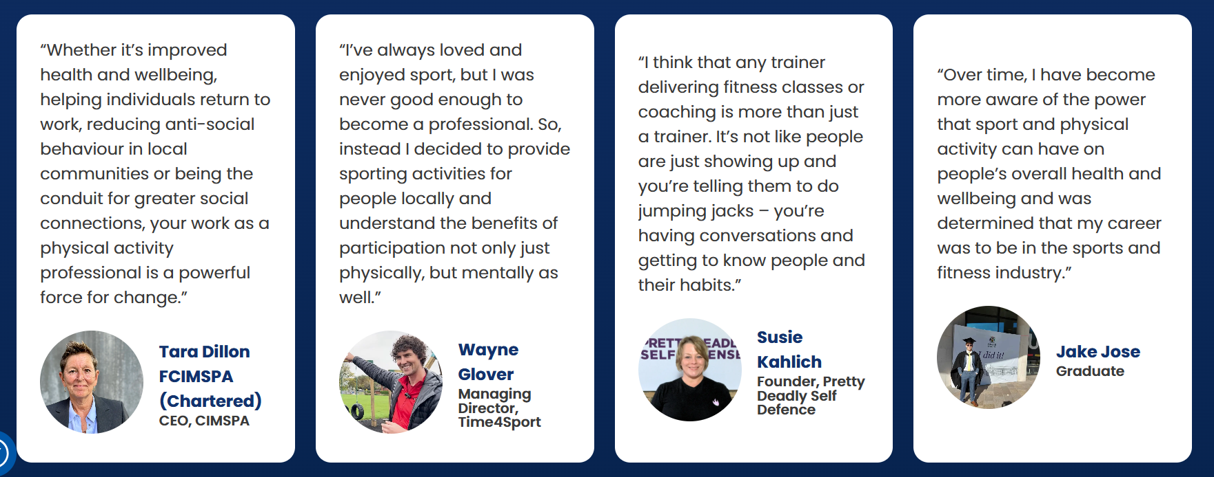

Slide 8


Slide 9
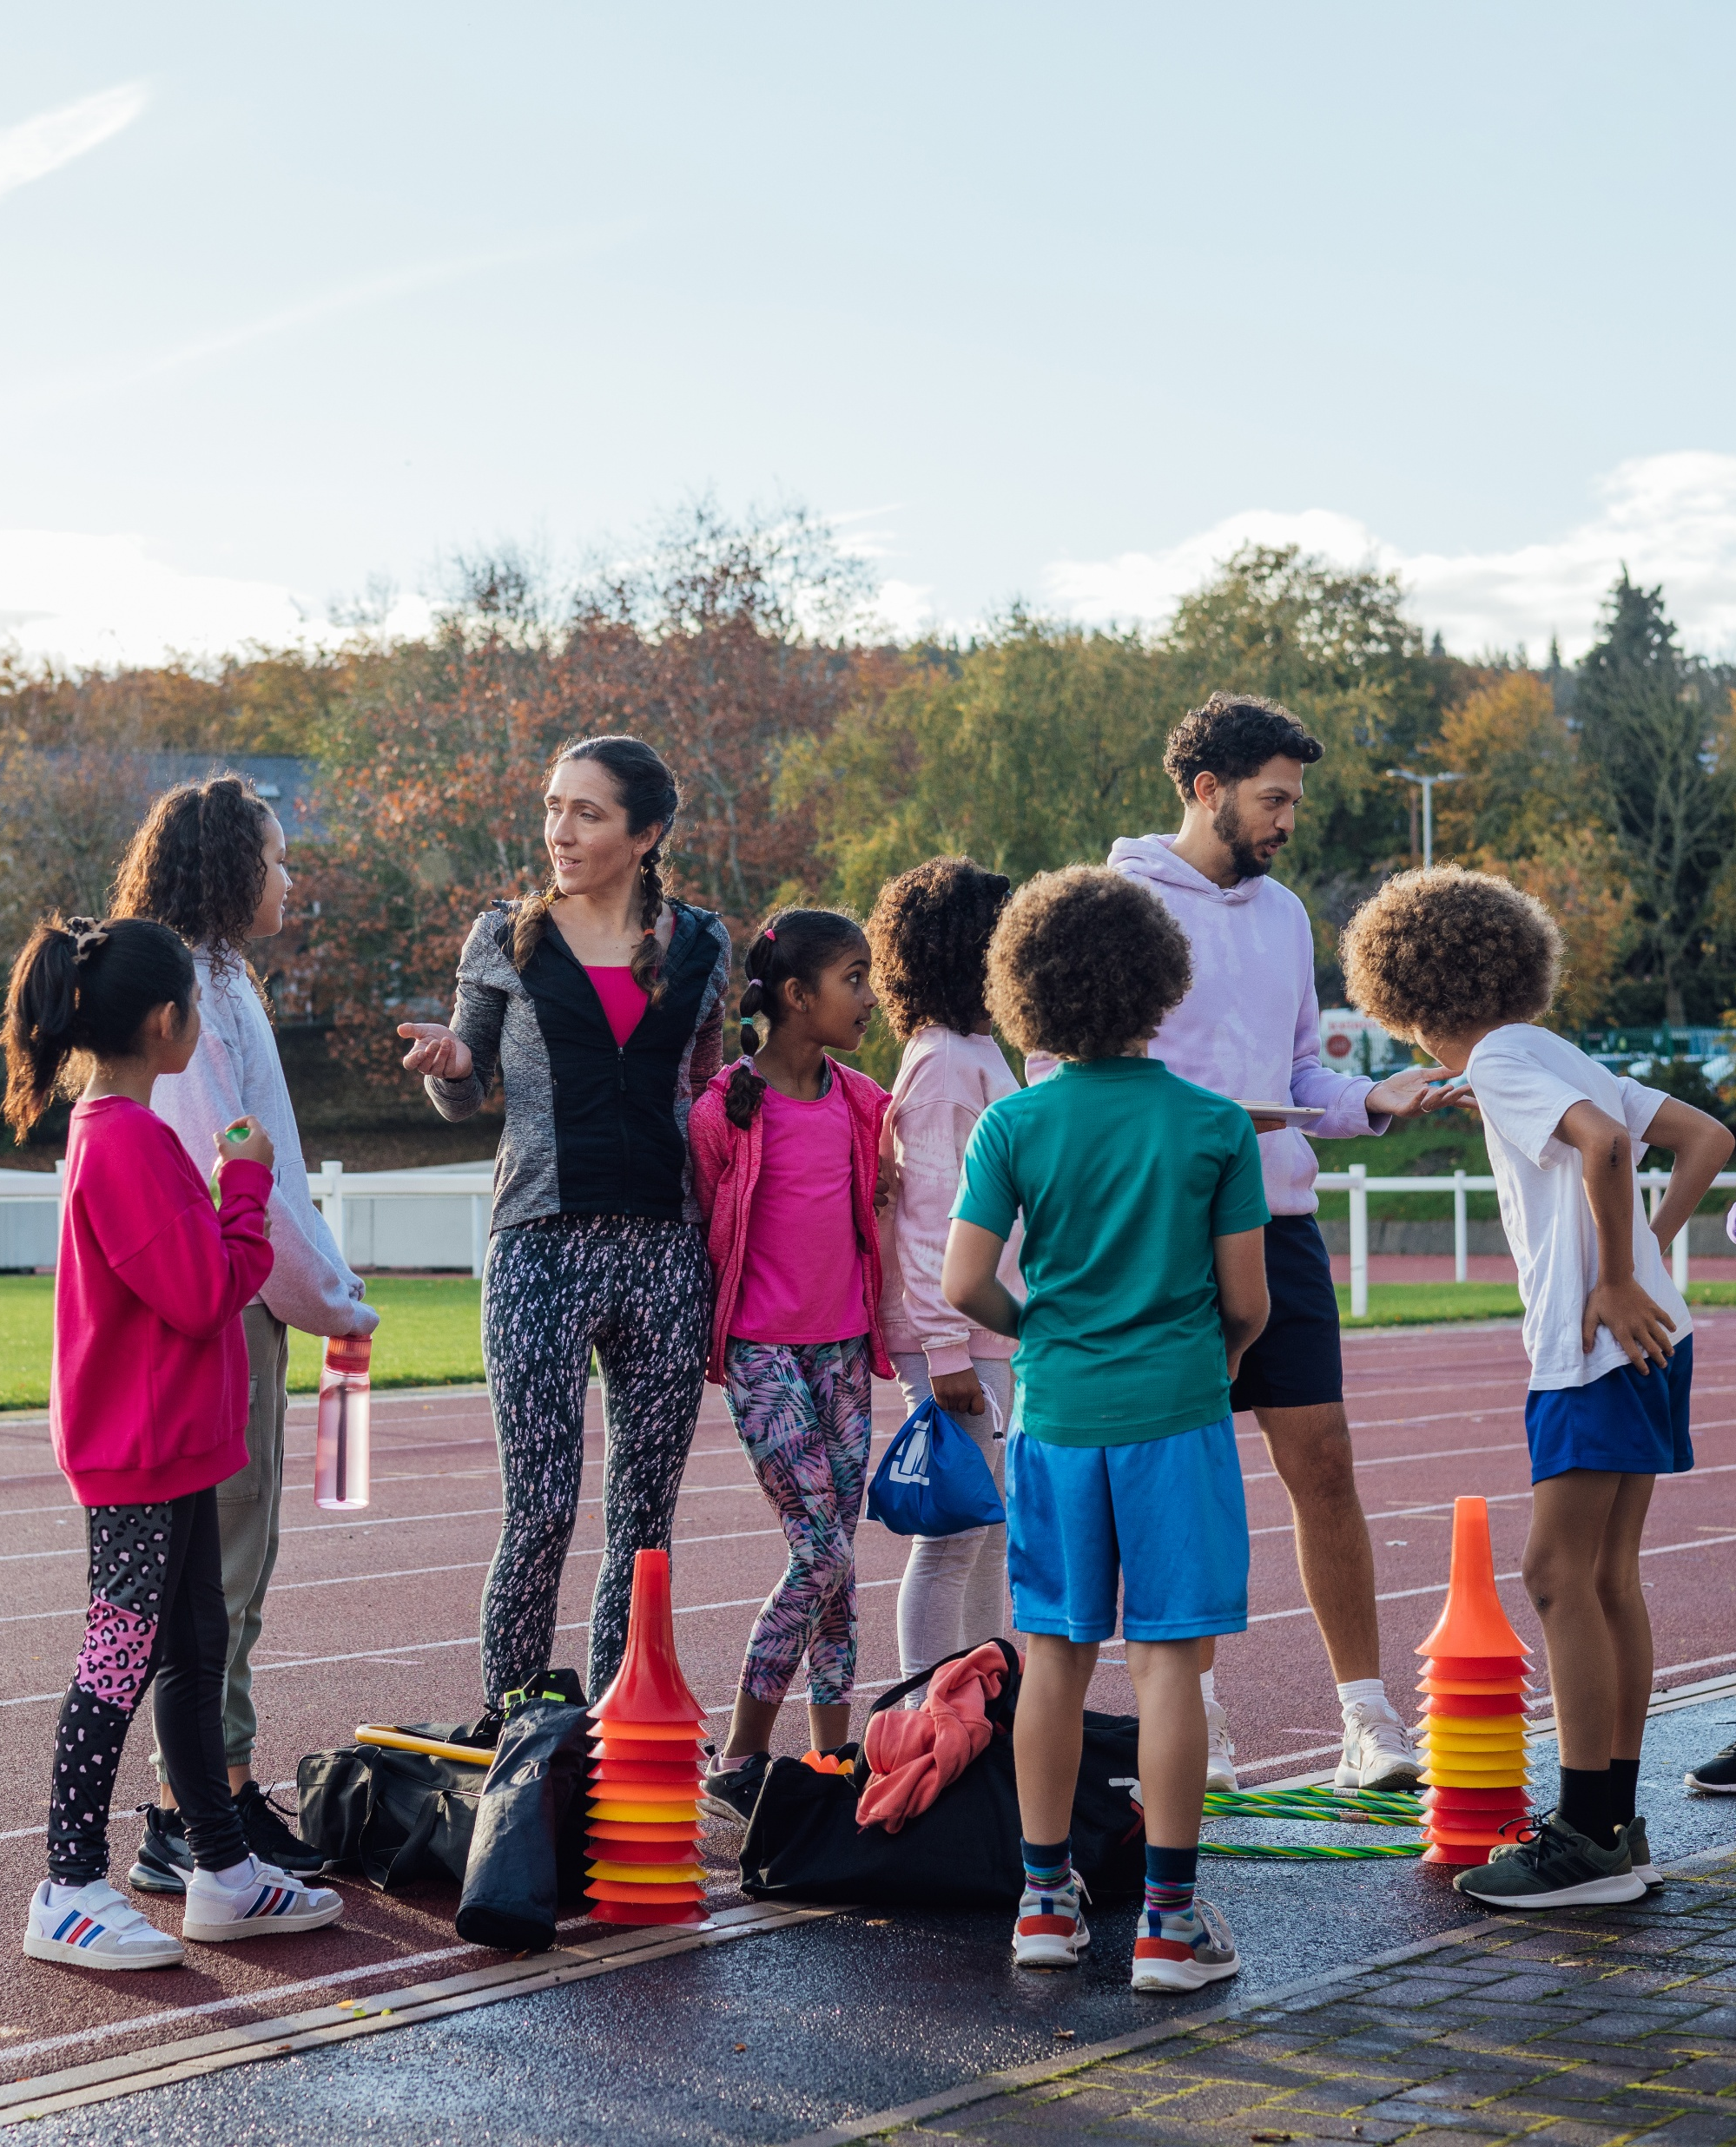
Why choose a career in sport and physical activity?
Rewarding and impactful work
Inspire others
Help individuals and communities to lead healthier, happier lives. From coaching young athletes to organising community fitness programmes, your work can inspire others to get and stay active as well as improve their wellbeing.
Build communities
Sports and physical activities bring people together. As a professional in this sector, you’ll play a big role in fostering community spirit and teamwork.

Slide 10

Why choose a career in sport and physical activity?
Career progression and opportunities
Diverse career paths
Whether you’re interested in coaching, sports management, physical therapy or fitness training, the sport and physical activity sector has a career to inspire you. There is wide range of roles to explore, with each with ways to progress as you gain more experience and knowledge. You could even specialise in areas like sports psychology, nutrition or event management.
Growth and advancement
The sport and physical activity sector is growing rapidly. According to the UK Department for Digital, Culture, Media and Sport, the sector contributes over £39 billion to the UK economy and supports over 600,000 jobs. This growth means more opportunities for career advancement and professional development, giving you options and flexibility whatever role you choose.

Slide 11

Why choose a career in sport and physical activity?
Skill development
Transferable skills
Working in sport and physical activity helps you to develop a wide
array of skills that are valuable in any career. These include leadership, teamwork, communication, problem-solving and time management.
Specialised knowledge
Gain expertise in areas such as exercise science, sports medicine
and fitness training. These specialised skills are highly sought after
and can lead to numerous career opportunities and ways to connect
with new people.

Slide 12
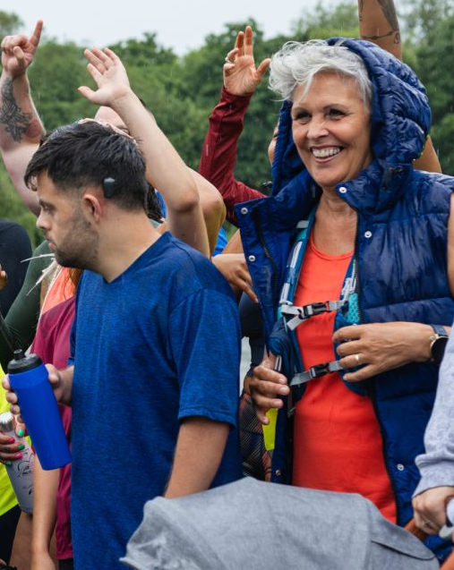
Feeling included in the sport and physical activity sector
Equality, diversity and inclusion in
the sport and physical activity sector
We know that it doesn’t always feel like there’s
a place for everyone in the world of sport and physical activity, but we want to change that. No matter who
you are, there is a role for you in our sector. To show
you what that might look like, we’re offering guidance
on the opportunities available to people from disadvantaged groups.
We have resources on the CIMSPA Careers Hub to support Disability, Ethnic Diversity, Gender, LGBTQIA+, Economic Disadvantage, Neurodiversity

Slide 13
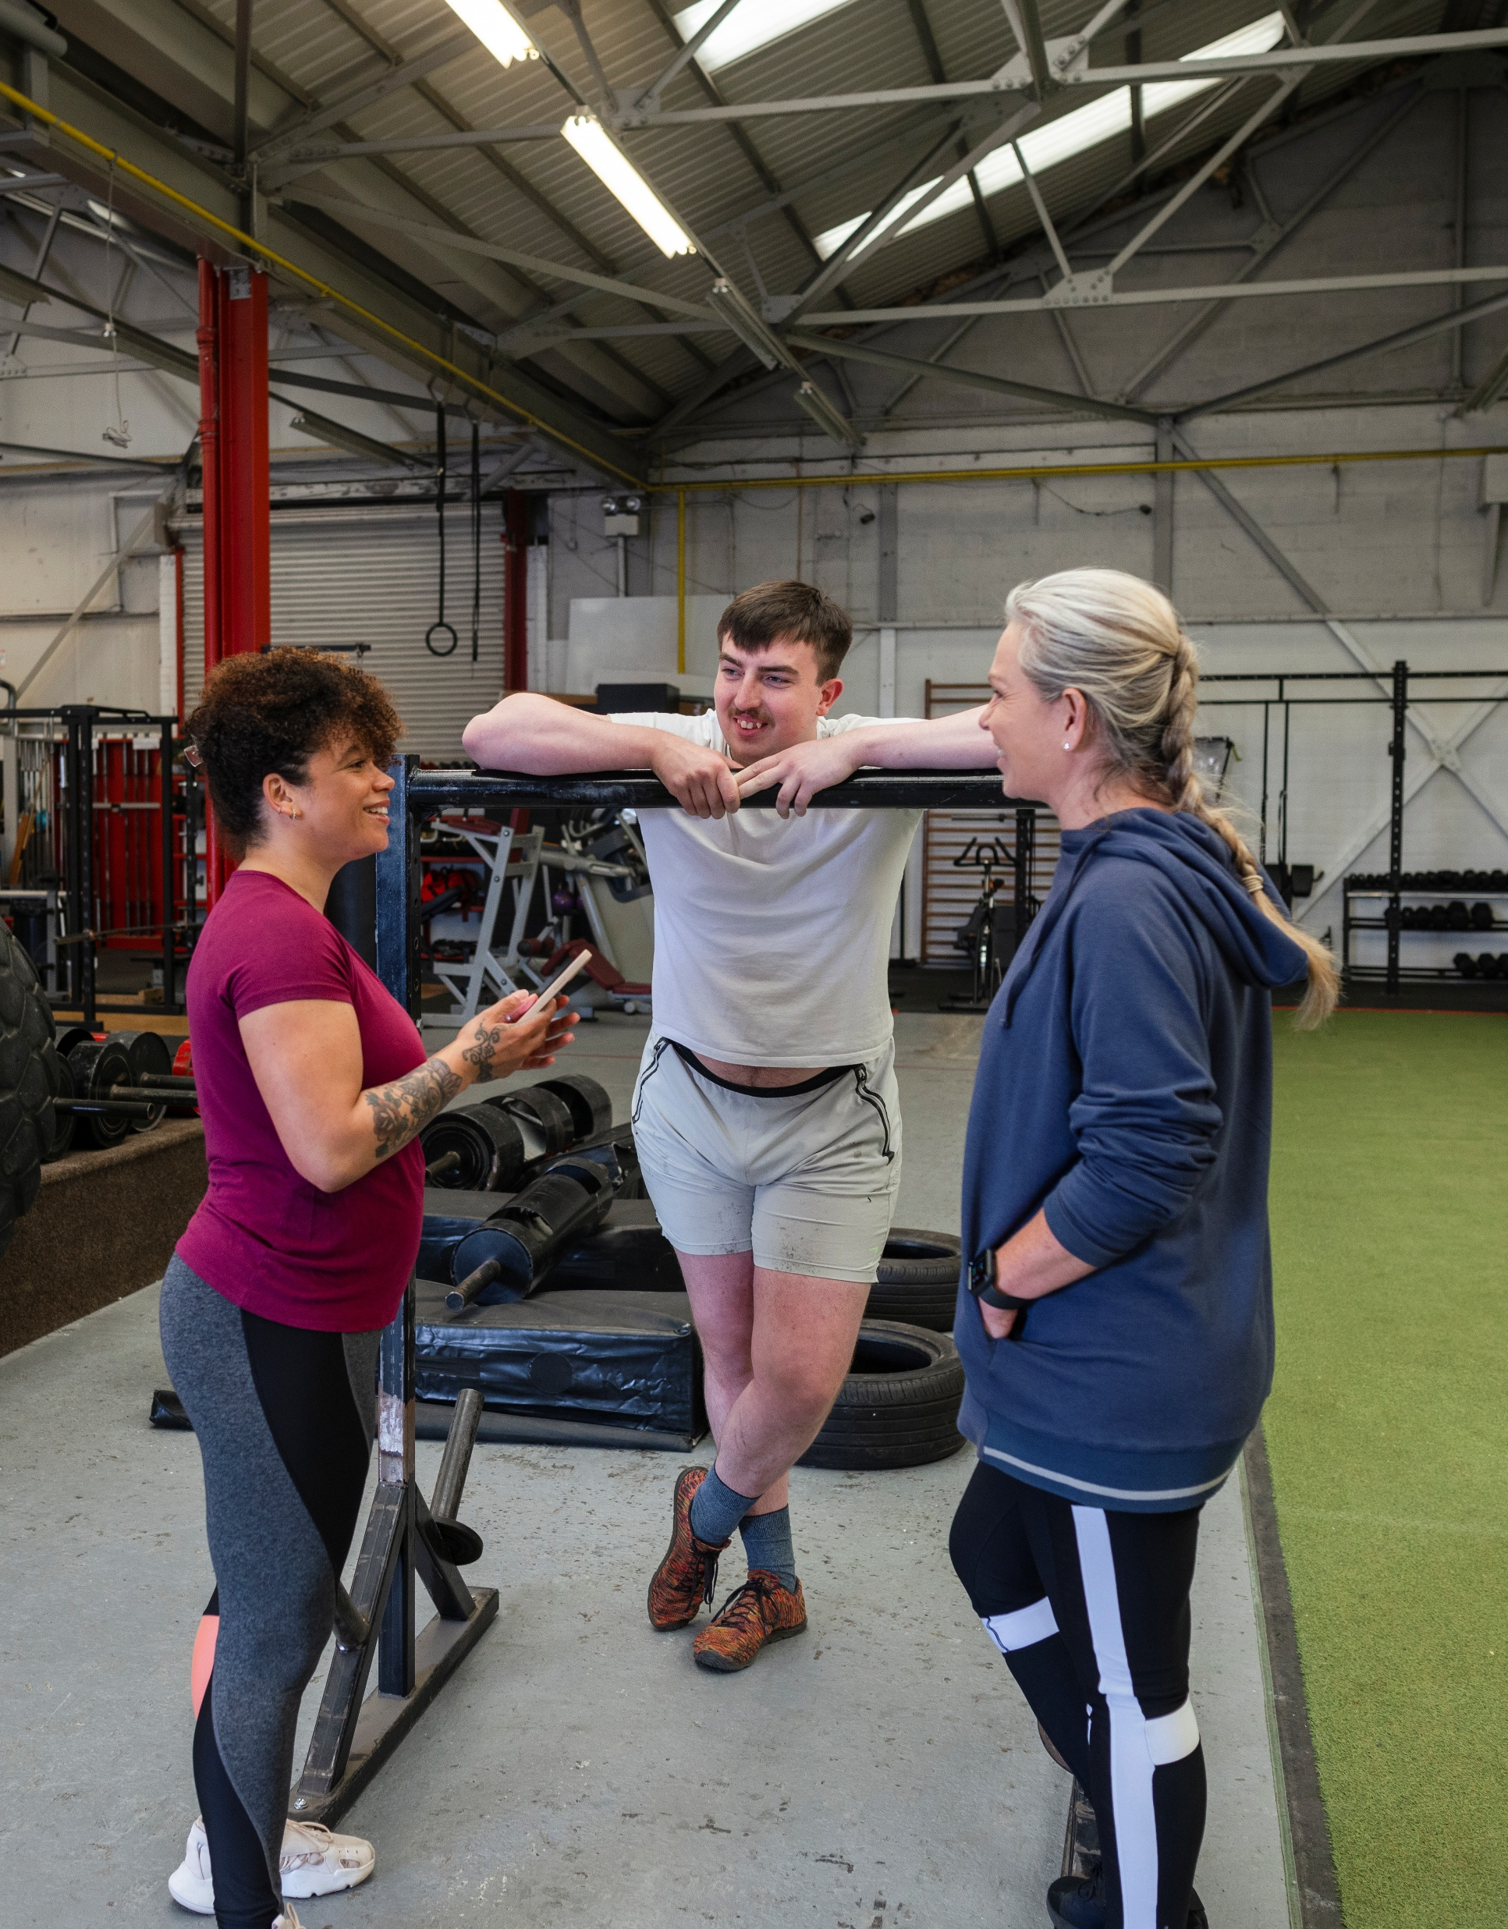
Has your perception
of what it's really like
to work in the sector changed? If so, how?

Slide 14
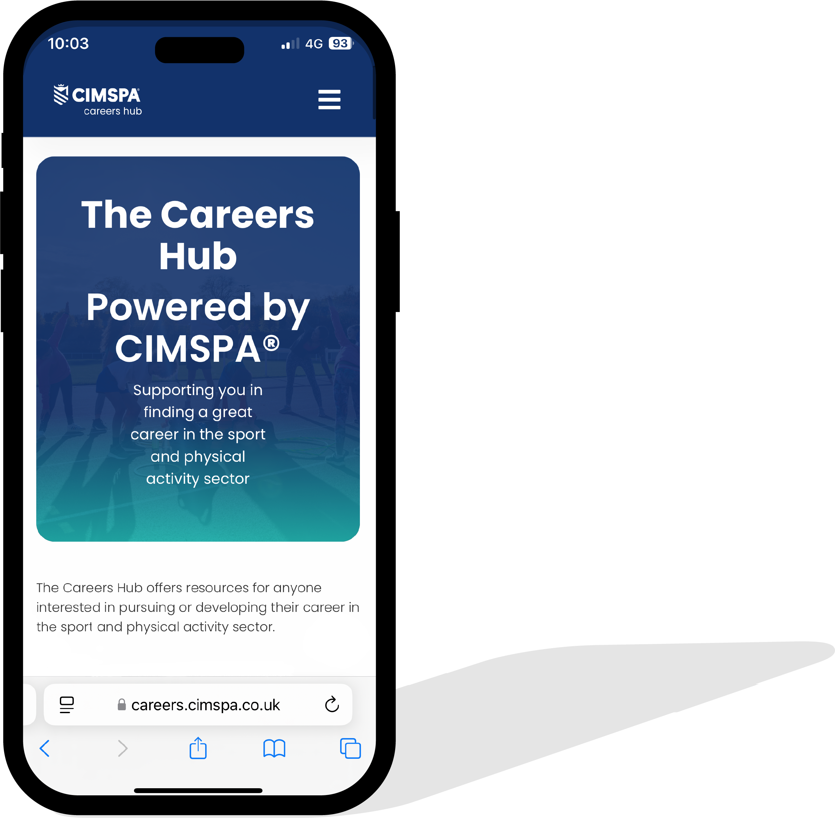
Careers Hub
The Careers Hub offers resources for anyone interested in pursuing or developing their career in the sport and physical activity sector.
We highlight the diverse and rewarding opportunities available and support individuals
from all backgrounds in entering an exciting
and dynamic industry that plays a crucial role
in promoting health, well-being, and community engagement across the UK.
Visit: www.careers.cimspa.co.uk

Slide 15



Slide 16
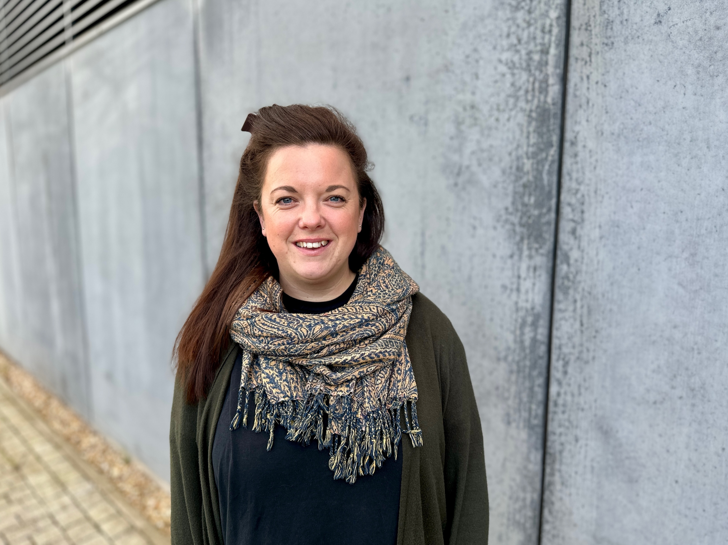
Find out more
www.cimspa.co.uk
CIMSPA Technical Education contact:
Micki Ruggins: micki.ruggins@cimspa.co.uk

